Slide 1


Enterprise SQL Server
Best Practices
A comprehensive blueprint for high performance, continuous availability, defense-in-depth security, and cloud scalability.
Hardware & Config
Security & DR
Tuning & DevOps

Slide 2




High-Performance Hardware Setup
High Core Clock CPUs: Prioritize higher CPU clock speeds (GHz) over core count to reduce licensing costs and maximize single-thread query performance. Align with NUMA nodes.
RAM Sizing: Provision sufficient RAM to keep the active data working set inside the Buffer Pool, minimizing slow disk I/O operations.
PCIe NVMe SSD Storage: Deploy NVMe flash storage with RAID 10 for transaction logs and TempDB to achieve sub-millisecond write latencies.
Dedicated Network Fabric: Separate user traffic, backup streams, and Always On availability replica traffic across redundant 25GbE+ NICs.

Slide 3








Engine Configuration Best Practices
Memory Tuning
MAXDOP & Parallelism
TempDB Optimization
Prevent OS thrashing & buffer pool depletion.
Eliminate CPU thread contention & CXPACKET wait time.
Remove allocation latch contention (PAGELATCH_EX).
•
Max Server Memory: Set cap leaving 10-20% RAM reserved for the Windows OS.
•
MAXDOP: Cap at NUMA node boundary (max 8) for OLTP workloads.
•
Data Files: Match 1 file per logical CPU up to 8 equal-sized data files.
•
Lock Pages in Memory (LPIM): Enable privilege to prevent OS swapping buffer pool to disk.
•
Cost Threshold: Raise default from 5 to 50+ to stop trivial parallel query overhead.
•
Fixed Autogrowth: Presize files with large explicit growth chunks (e.g., 1024MB).

Slide 4

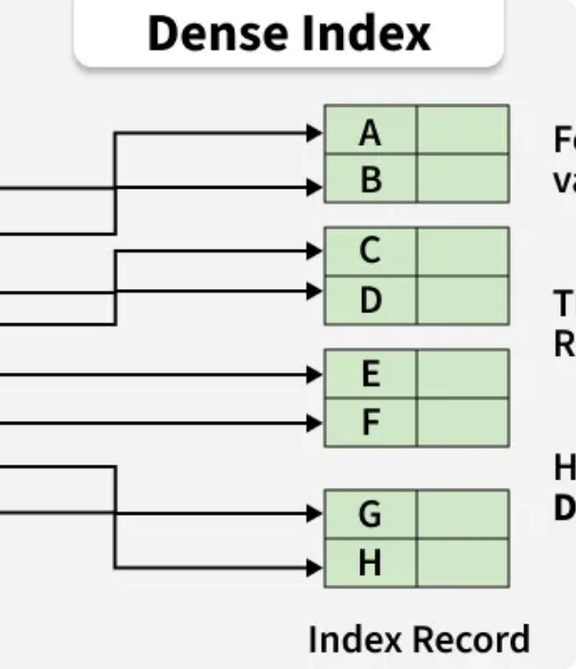

Efficient Indexing & Maintenance
Structured Lifecycle Strategy
Proper index design and routine hygiene ensure fast execution plans while maintaining lean storage overhead.
Index Selection: Combine B-Tree indexes for OLTP workloads with Columnstore indexes for analytical reporting.
Automated Maintenance: Reorganize indexes with 10-30% fragmentation; rebuild indexes above 30% weekly.
Statistics Updates: Update query optimizer statistics daily to avoid stale execution plans.
Table Partitioning: Partition multi-million row tables by date ranges for efficient partition pruning and slide archiving.

Slide 5

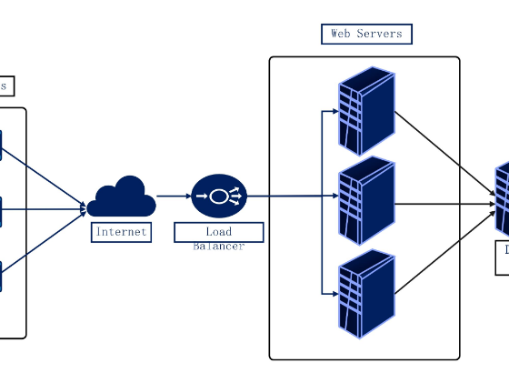
High Availability & Geo-Replication
Always On Availability Groups: Configure synchronous commit for local zero-data-loss failover and asynchronous commit for secondary disaster recovery (DR) sites.
Windows Server Failover Cluster (WSFC): Leverage multi-subnet cluster listeners for seamless, automatic IP failover for connected application pools.
Readable Secondaries: Offload read-heavy reporting queries and backup tasks to active secondary replicas to reduce primary engine stress.
Automatic Page Repair: Transparently resolve corrupt disk pages on the primary replica by fetching clean copies from a secondary replica.

Slide 6



In-Memory OLTP & Data Governance
In-Memory OLTP (Hekaton)
Data Governance & Archiving
Designed for high-concurrency ingestion and ultra-low latency transaction processing.
Maintain compliance while optimizing storage costs and data freshness.
Memory-Optimized Tables: Non-blocking lock/latch-free execution eliminates thread contention.
Automated Tiering: Migrate historical cold data to low-cost cloud blob storage tiers.
Quality & Metadata: Enforce strict schemas, foreign keys, and document relationships with data catalogs.
Natively Compiled Stored Procedures: Transpiled to machine C-code for sub-millisecond execution times.

Slide 7








Robust Backup & Recovery Flowchart
An enterprise automated strategy ensures strict adherence to Recovery Point Objectives (RPO) and Recovery Time Objectives (RTO).
Full Backup
Differential
Tx Log Backups
DR Validation
Weekly full database backups written directly to encrypted, geo-redundant storage.
Daily differential backups to capture extent changes and accelerate restore chains.
Frequent log backups (every 5-15 mins) enabling precise point-in-time recovery.
Automated daily restore verification testing to validate backup file integrity.

Slide 8








Defense-in-Depth Security & Compliance
🔒 Encryption Standard
👥 Access Control (RBAC)
📜 Auditing & Logging
•
Transparent Data Encryption (TDE): Encrypts entire database storage at rest using HSM-backed keys.
•
Least Privilege: Enforce strict Role-Based Access Control via Entra ID / Active Directory Groups.
•
SQL Server Audit: Log server-level logins, schema changes, and elevated privilege access.
•
Always Encrypted: Protects sensitive column data (SSNs, credit cards) in-transit and at-rest from DBAs.
•
No Direct Sa Access: Disable default 'sa' accounts; grant temporary admin rights via JIT privilege tools.
•
Compliance Ready: Standardized audit logs formatted for GDPR, HIPAA, and PCI-DSS compliance reviews.

Slide 9






Monitoring & Health Benchmarks
Performance Metric | Target Health Threshold | Recommended Remediation Action
Buffer Cache Hit Ratio | > 99% Target | Increase Server Memory; rewrite queries generating excessive disk reads.
Page Life Expectancy (PLE) | > 300s per 4GB RAM | Investigate memory pressure, missing indexes, or large table scans.
Index Fragmentation | < 10% Ideal | Automate Maintenance Tasks: Reorganize (10-30%), Rebuild (>30%).
Patch & CU Management | Latest CU - 1 | Apply Cumulative Updates & Security GDR patches via staging environment.

Slide 10







Database Automation & DevOps
⚙️ CI/CD Pipelines
🧪 Automated Testing
📝 Infrastructure as Code
Automate schema migrations safely.
Catch bugs before production push.
Repeatable server provisioning.
•
Declarative Deployments: Build & publish database project artifacts (.dacpac) via GitHub Actions or Azure DevOps.
•
Unit Testing: Run tSQLt unit tests to validate stored procedure logic and output contracts.
•
Automated Provisioning: Manage SQL instances, logins, and configurations using Terraform and Ansible.
•
Execution Plan Check: Catch implicit conversions and parameter sniffing during PR validation.
•
PowerShell dbatools: Standardize migration scripts, instance cloning, and automated health checks.
•
Zero-Downtime Releases: Execute backward-compatible schema scripts without blocking table access.

Slide 11


Scalable Cloud & Hybrid Architecture
Horizontal Scale-Out: Utilize Read-Scale Availability Groups to distribute analytical queries across multiple secondary read-only nodes.
99.99%
Azure SQL Managed Instance: Migration path for legacy on-prem workloads requiring full SQL engine compatibility with automatic cloud updates.
High Availability SLA Benchmark
Achieved through multi-region Availability Groups and automated failover groups in hybrid cloud environments.
Elastic Pools: Consolidate multi-tenant enterprise database workloads with dynamically shared compute & memory resources.

Slide 12

Questions & Discussion
Building resilient, high-performance, and secure enterprise SQL Server environments.
NVMe & Memory Tuned
TDE & RBAC Secure
Always On HA / DR

Slide 13
BN TECHALLIANCE PRIVATE LIMITED
Be connected with us, for more Database question and details:
Gandhi Nagar, Jammu
Phone: +91 70065 77297, Email: admin@bntechallinace.com

